Slide 1
Final Presentation
What makes an Italian restaurant successful in Philadelphia
Group6: Baiheng Chen, Ziang Zeng, Ruizhen Jing

Slide 2
Introduction and Background Information
Key words: Restaurants, Food, Italian
City: Philadelphia
Data size: 505 Italian restaurants, 73369 reviews
Research Goal: What factors contribute to the success of Italian restaurants in Philadelphia?

Slide 3
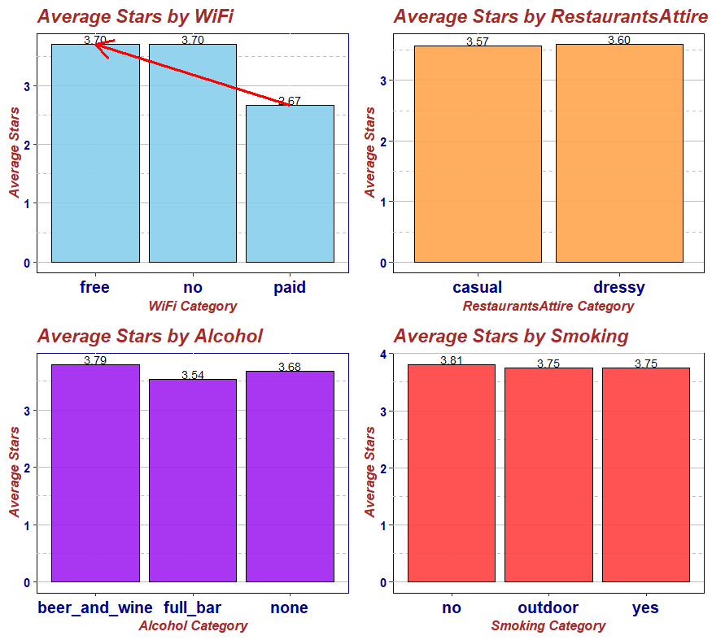
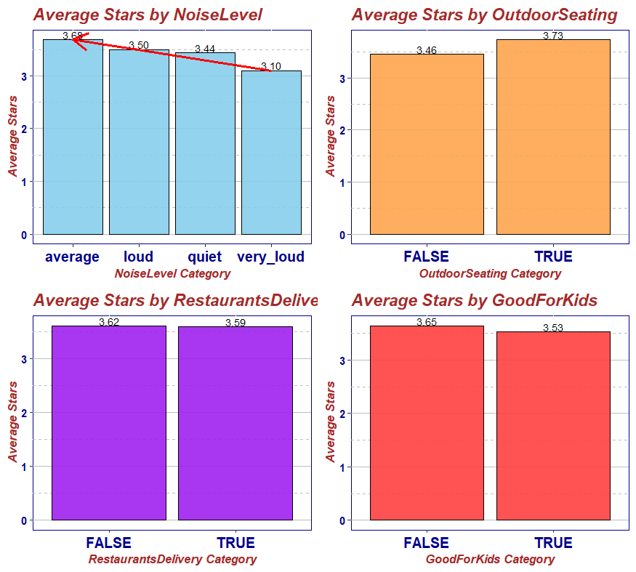
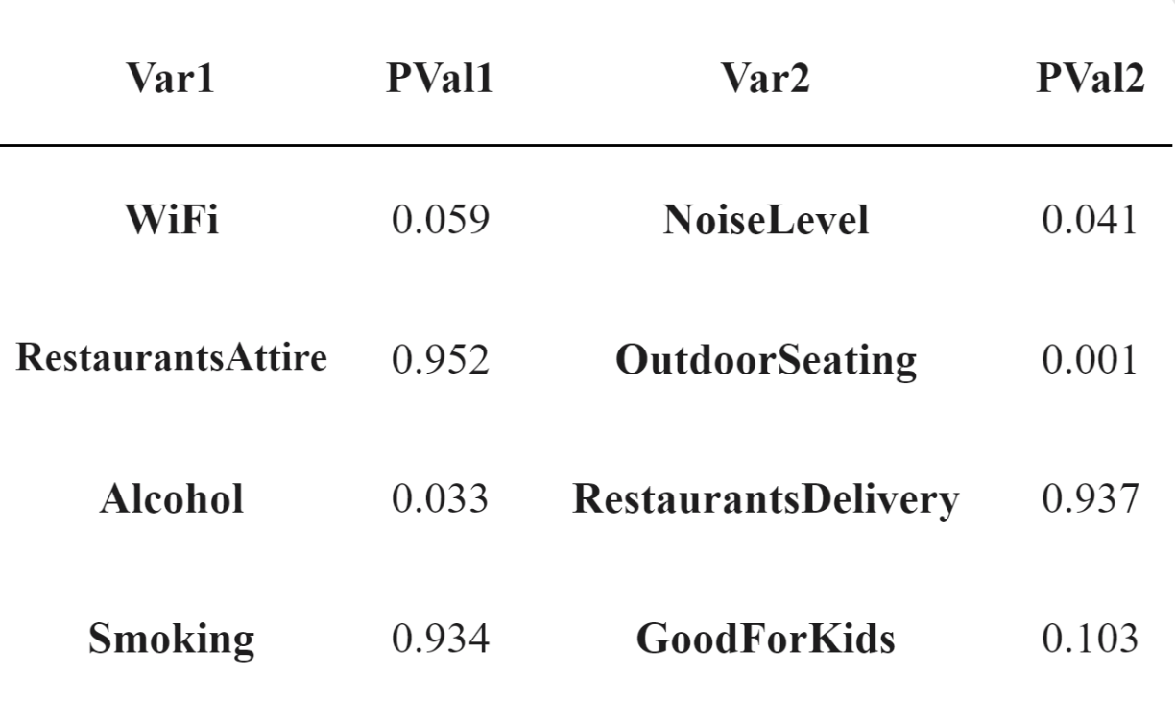
Attribute Analysis

Slide 4
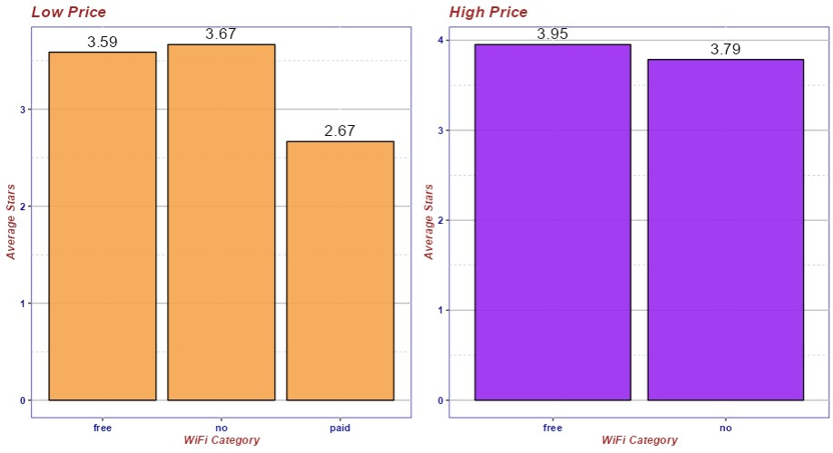
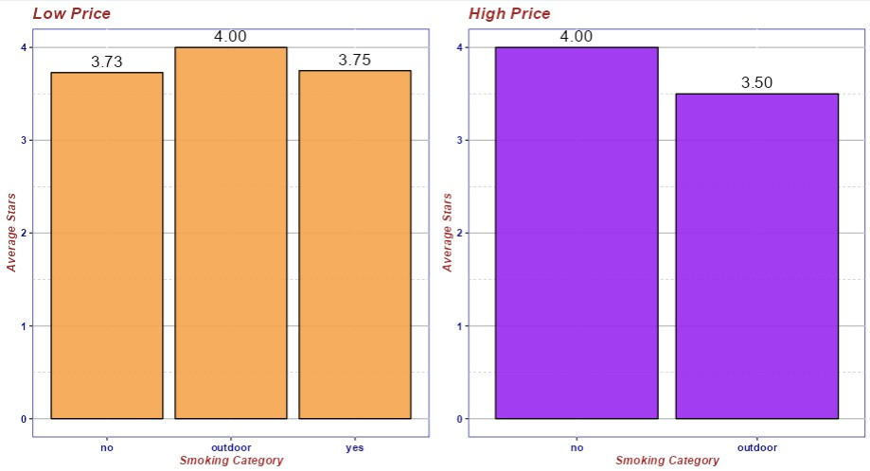
Difference When dividing Price range

Slide 5
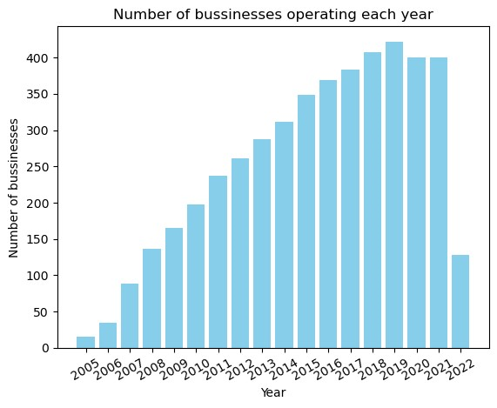
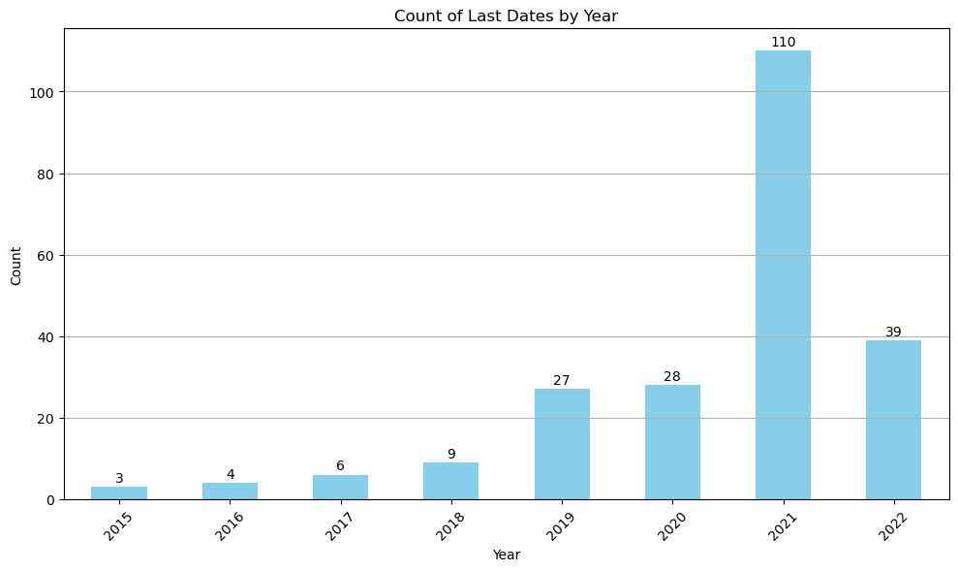
Impact of COVID-19
Notes:
We conducted an analysis of the annual trends of opening and closing Italian restaurants in Philadelphia. Under normal circumstances, the number of Italian restaurants in operation and the number of closures increase steadily every year, indicating a stable market for this cuisine. However, this growth pattern was disrupted between 2020 and 2022, especially in 2021, when 110 Italian restaurants shut down. This situation partly explains the negative impact of COVID-19 on the restaurant industry just as we expected.

Slide 6
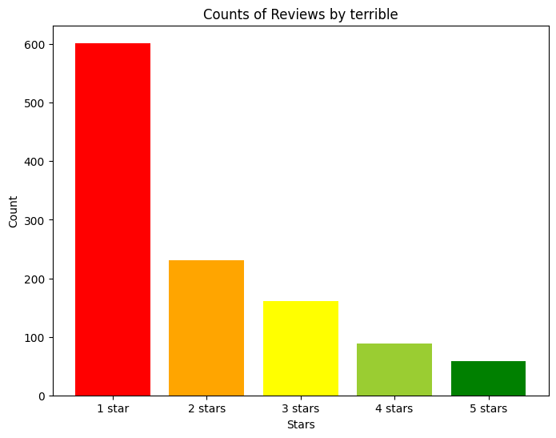
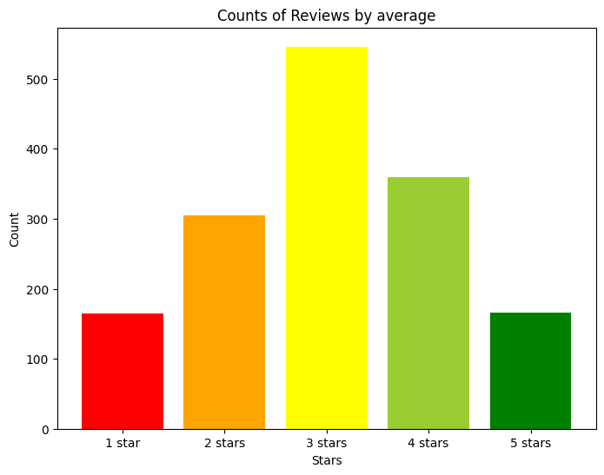
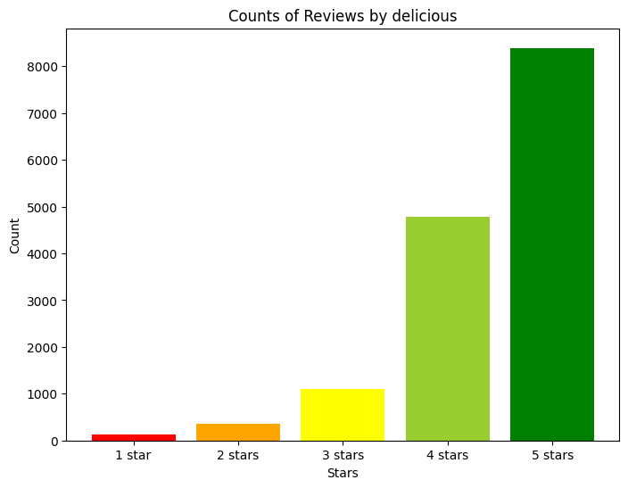
Terrible
Distribution of emotional tendency words
Average
Delicious

Slide 7
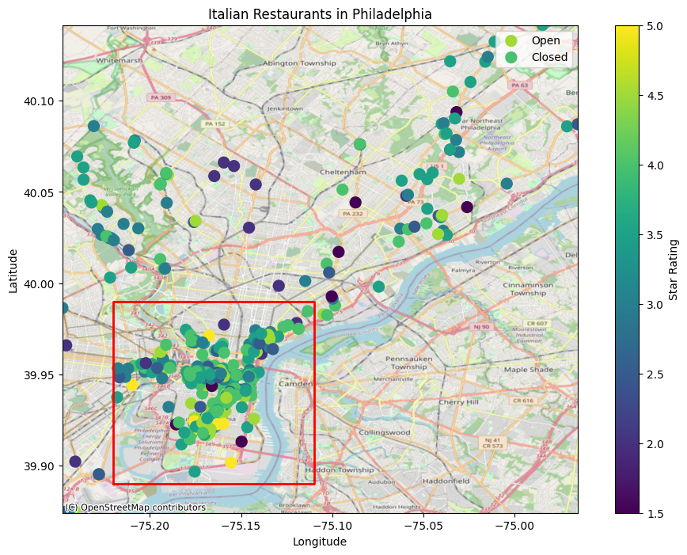
Categorize Restaurant by Location and Price
Location | Longitude | Latitude
Lower bound | -75.22 | 39.89
Upper bound | -75.11 | 39.99

Slide 8
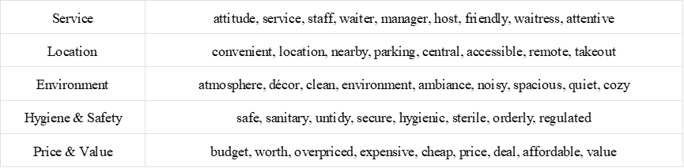
Indicators to evaluate Italian restaurants
Notes:
We divided the evaluation of the restaurant in the review into five specific indicators, Service, Location, Environment, Hygiene & Safety and Price & Value. This table shows the specific words that each indicator contains.

Slide 9
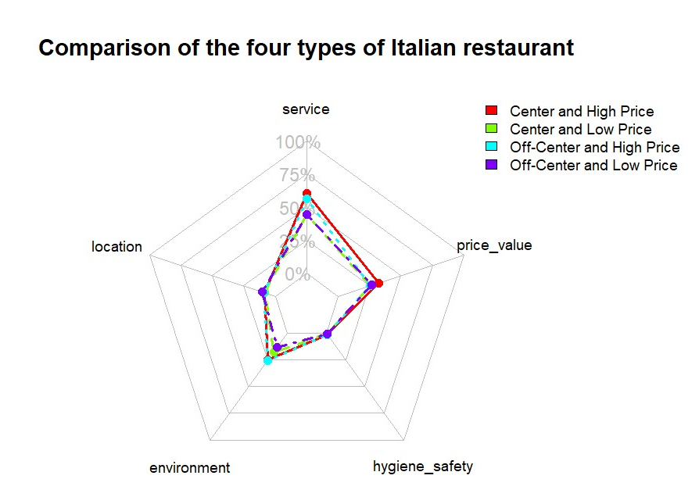
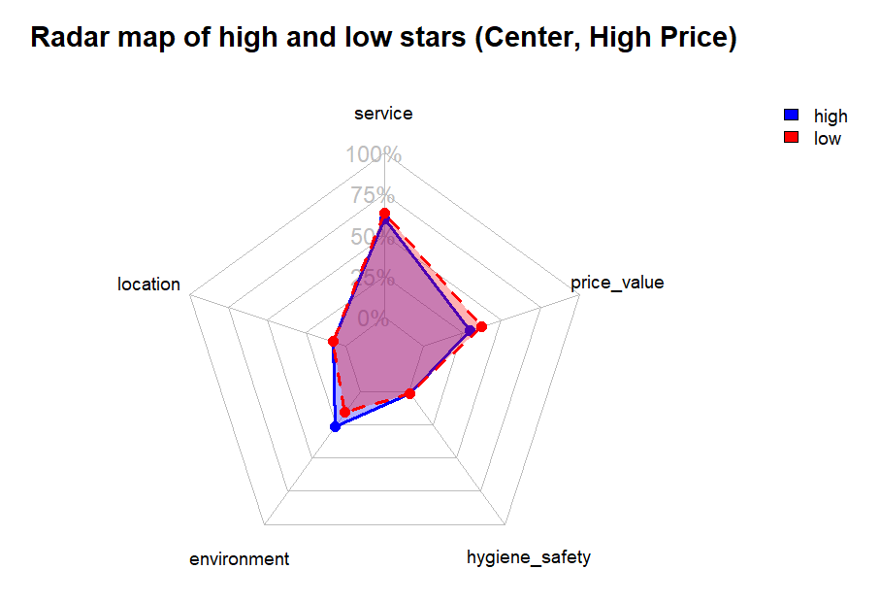
Radar map based on 5 indicators
Notes:
The radar chart shows that location and Hygiene & Safety are less important for most reviews. High-priced restaurants need to have good service and environment, while low-priced restaurants need to have good value for money. Low priced downtown restaurants also need to have a nice ambiance. Price & Value is more relevant for high-priced downtown restaurants than others. We also evaluated each category of restaurant based on the five indicators and compared the high and low scores. This helped us identify the key factors for success for each category. For example, for high-priced downtown restaurants, customers value environment, service, and Price & Value. High-rated restaurants have better environment than low-rated ones, while low-rated restaurants have more complaints about Price & Value. High-priced restaurants need to provide an excellent dining ambiance to earn customers’ praise. A poor dining experience can make customers feel that the restaurant is not worth the money.

Slide 10
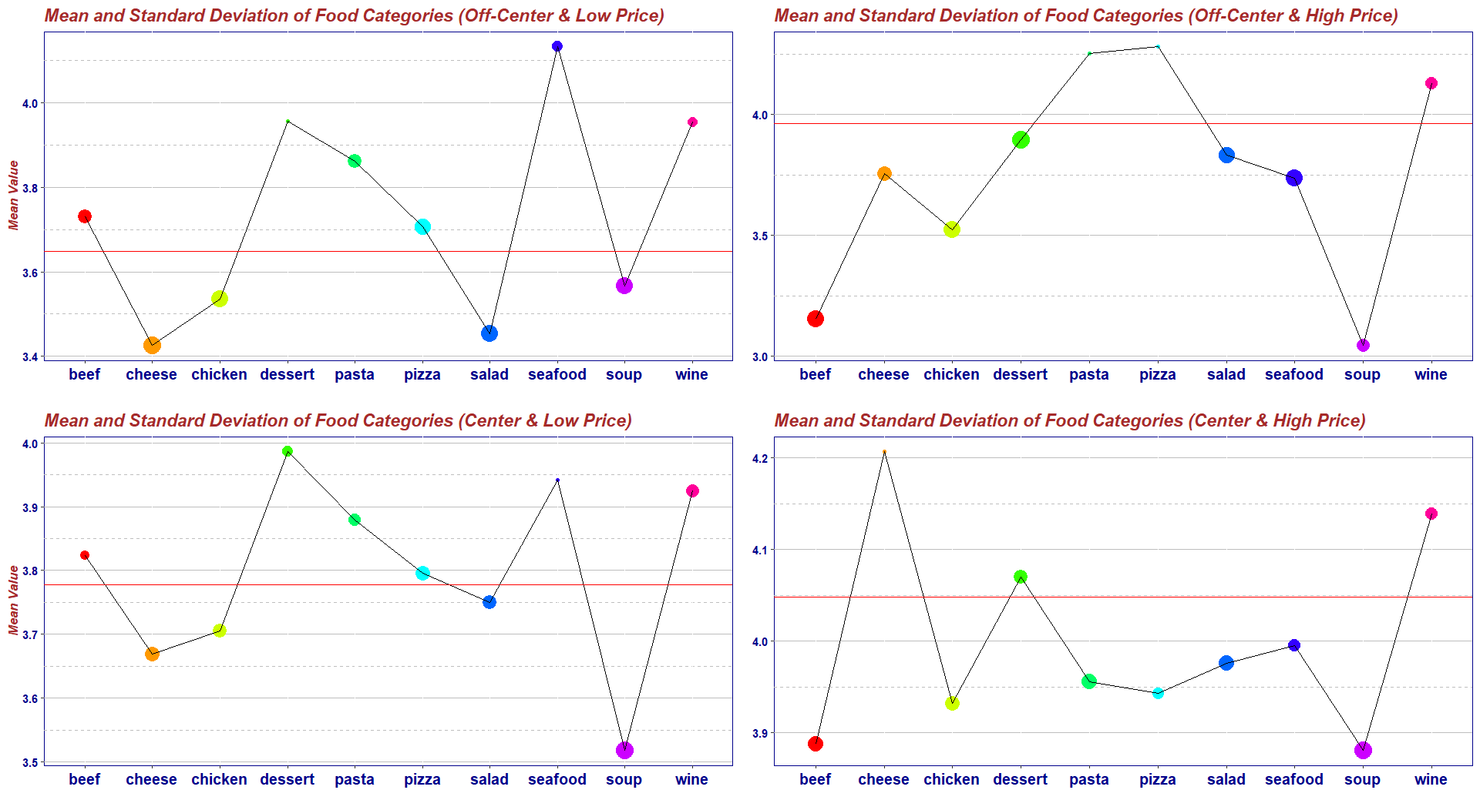
Food analysis
Notes:
We examined how food quality affects a restaurant’s rating. We selected the dishes most mentioned in the reviews, such as Pizza, Cheese, Dessert, Chicken, Salad, Pasta, Wine, Soup, Seafood and Beef. We compared how these dishes influenced the ratings of the four types of restaurants and made a line chart. The chart shows the dish name, the rating, the average rating of the reviews that mention the dish, and the rating variance of those reviews. We think that a dish with a higher average rating and a lower rating variance helps a restaurant get a better rating. For example, for high-priced downtown Italian restaurants, cheese and wine are effective choices to enhance the restaurant ratings, as they are often praised by the customers. However, beef and soup have a large variation in quality among different restaurants, and they may even be the worst dishes in some cases.

Slide 11
Questions

